Slide 1
Chapter 3:
Networking

Slide 2
Chapter Overview
Spam
Internet interactions
Text messaging
Censorship
Freedom of expression
Children and inappropriate content
Breaking trust
Internet addiction
1-<number>

Slide 3
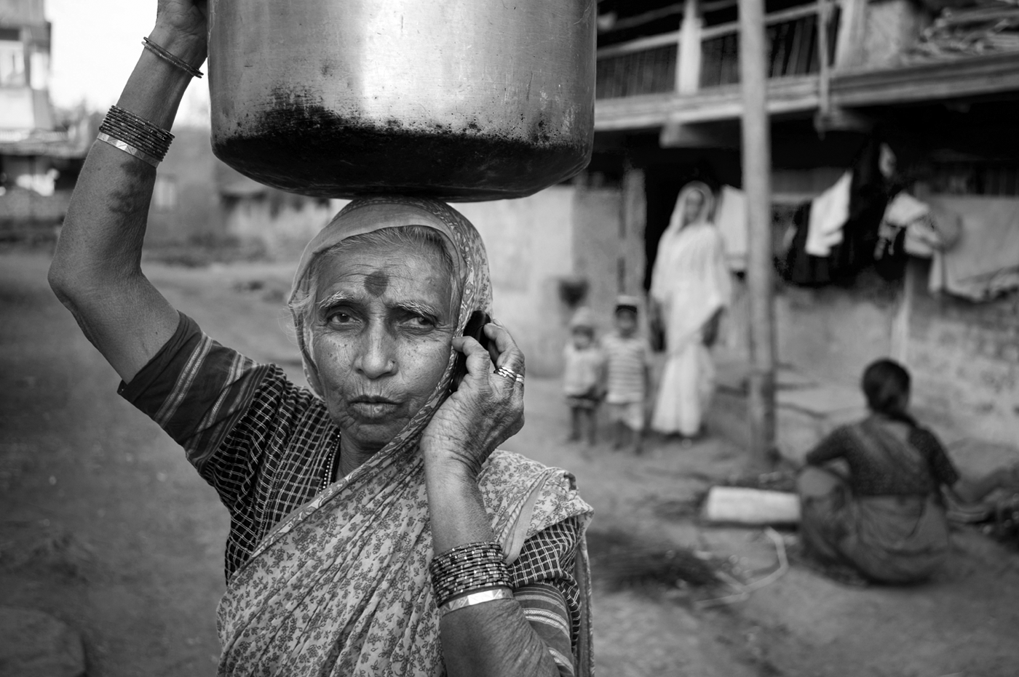
Far More People Have Access to Cell Phones than Electricity or Clean Water
Charles Sturge/Alamy
1-<number>

Slide 4
The Numbers behind Networks
Businesses need to communicate rapidly with customers, suppliers, and employees.
Almost 4 billion people worldwide use a mobile device to access the Internet
More than 2.6 billion people worldwide bought something online, spending about $5.7 trillion.
More than 3.6 billion people worldwide use a social network such as Facebook, Twitter, Instagram, or Pinterest, including 97 percent of Fortune 500 firms, who use them to communicate with their customers
(Insider Intelligence/ eMarketer, 2022)

Slide 5
3.2 Spam
1-<number>

Slide 6
The Spam Epidemic (1/3)
Spam: Unsolicited, bulk email
Spam is profitable
  More than 100 times cheaper than “junk mail”
  Profitable even if only 1 in 100,000 buys product
Amount of email that is spam has ballooned
  8% in 2001
  90% in 2009
1-<number>

Slide 7
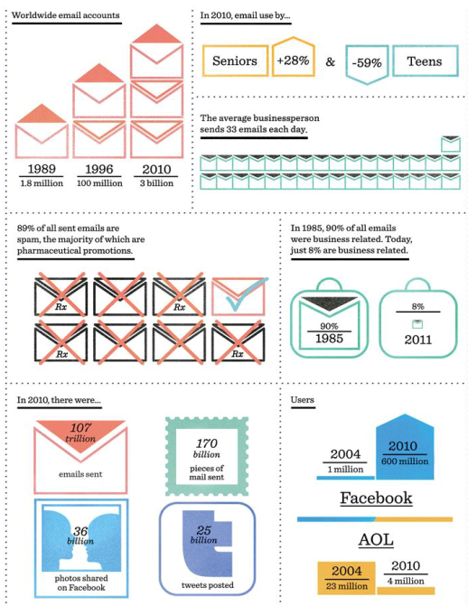
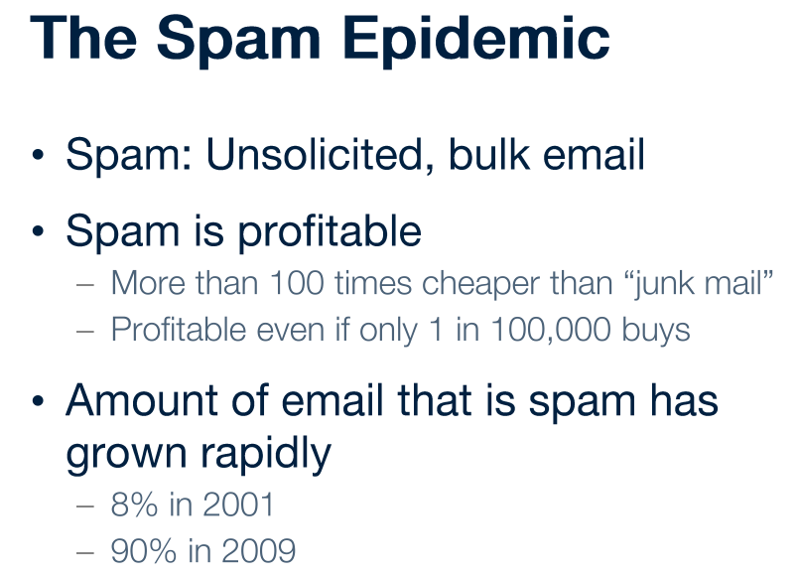
The Spam Epidemic (2/3)
1-<number>

Slide 8
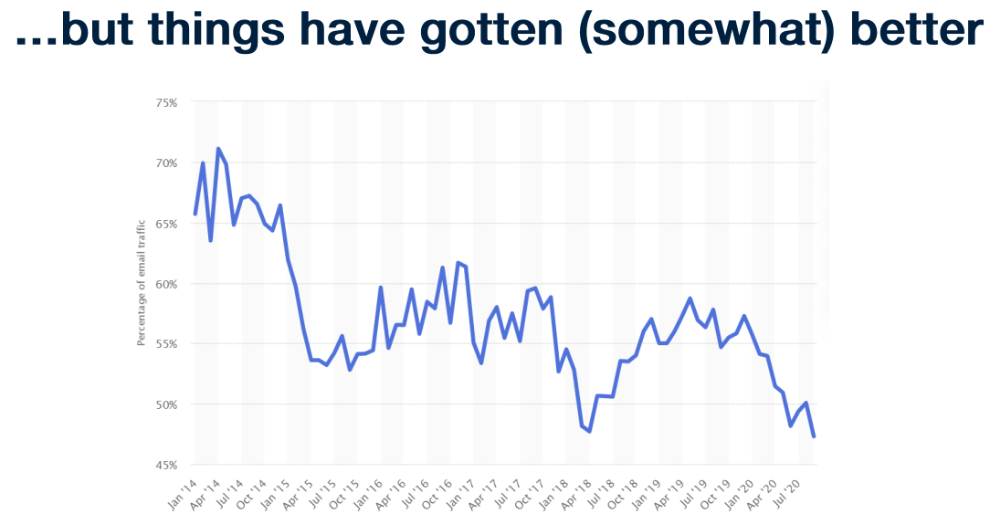
1-<number>

Slide 9
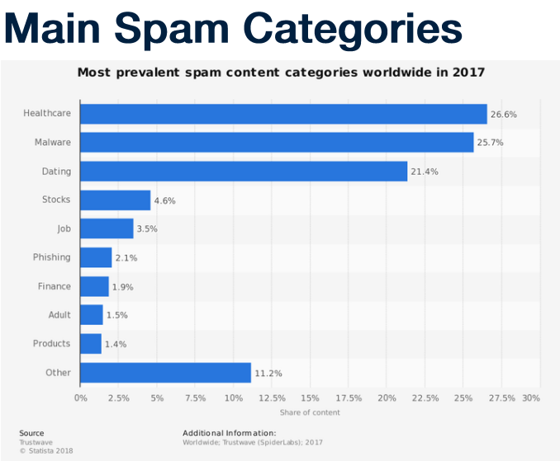
1-<number>

Slide 10
The Spam Epidemic (3/3)
How firms get email addresses
  Web sites, chat-room conversations, newsgroups
  Computer viruses harvest addresses from PC address books
  Dictionary attacks
  Contests
Most spam sent out by bot herders who control huge networks of computers
Spam filters block most spam before it reaches users’ inboxes
1-<number>

Slide 11
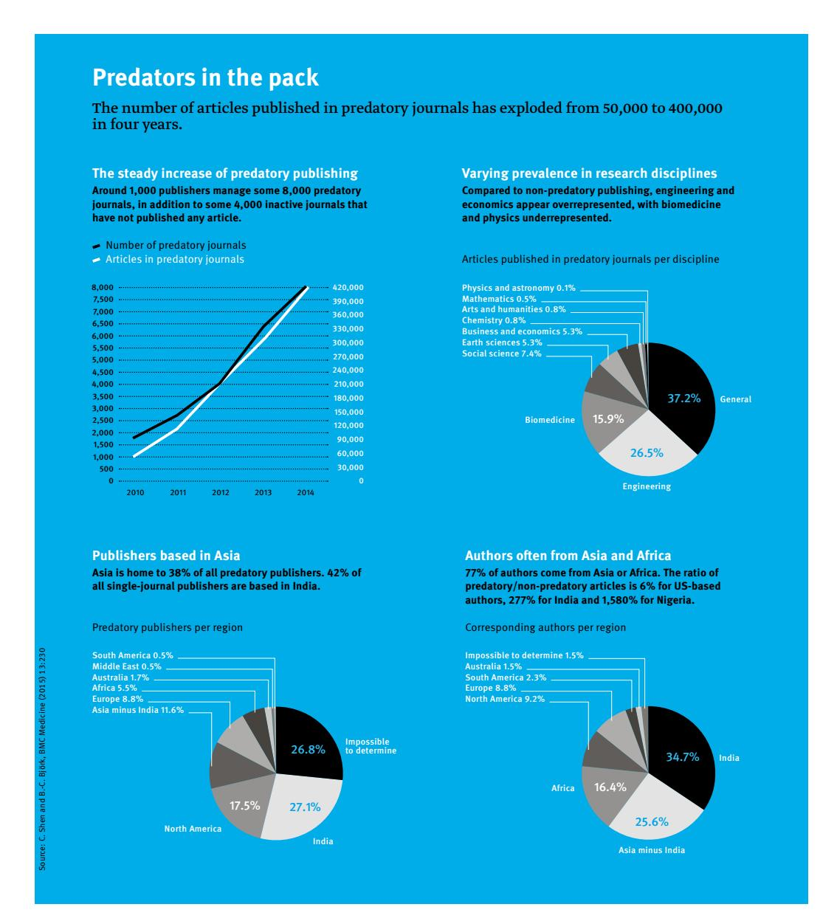
Science's spam epidemic
Total number of papers published worldwide in predatory journals rose from about 50,000 in 2010 to more than 400,000 in 2014
Hijacking journals
The Directory of Open Access Journals (DOAJ) – 9000 journals
1-<number>

Slide 12
Pakistani context - Protection from Spam, Unsolicited, Fraudulent and Obnoxious Communication Regulations, 2009
Administered by Pakistan Telecommunication Authority/ PTA
Requires that all operators (telecom operators licensed by the PTA) to establish a standard operating procedure to control spamming.
All such operators are required to develop a standard operating procedure for controlling unsolicited calls. The operators are also required to establish a consolidated “Do Not Call Register” in connection with controlling unsolicited calls. The operators are further required to ensure registration of telemarketers.
Punishable with imprisonment which may extend to three years or a fine which may extend to PKR 10 million, or both.
Source: https://iclg.com/practice-areas/data-protection-laws-and-regulations/pakistan
1-<number>

Slide 13
Case Study: Ann the Acme Accountant
Ann: Accountant at Acme Corporation
She distributes paychecks to all 50 employees
Ann sends email advertising Girl Scout cookie sale
9 recipients order cookies; average 4 boxes each
Other 40 recipients unhappy to get email; half complain to a co-worker
Did Ann do anything wrong?
1-<number>

Slide 14
Kantian Analysis
We should always respect autonomy of others, treating them as ends in themselves and never only as the means to an end (2nd formulation of Categorical Imperative)
Ann didn’t misrepresent what she was doing
She didn’t force anyone to read the entire email
Some who read her email chose to order cookies
Therefore, she didn’t “use” others, and her action was not strictly wrong
However, an “opt in” approach would have been better
1-<number>

Slide 15
Act Utilitarian Analysis
Benefit to Girls Scouts = $108
  $3 profit per box of cookies
  36 boxes sold
Harm to company: time wasted
  Orders taken during breaks
  Lost productivity from complaining: $70
    20 employees ×2 ×5 minutes/employee = 200 minutes
    3.5 hours ×$20/hour = $70
Benefits exceed harms, so action good
Company may create policy against future fundraisers
1-<number>

Slide 16
Rule Utilitarian Analysis
Q: What would be consequences of everyone in company used email to solicit donations?
A: Plenty of employee grumbling and lower morale
If all doing it, unlikely any one cause would do well
Harms greater than benefits, so Ann’s action was wrong
1-<number>

Slide 17
Social Contract Theory Analysis
Acme Corporation has no prohibition against using its email system this way
Ann was exercising her right to express herself
Some people didn’t appreciate message, but she didn’t act like a spammer
  She didn’t conceal her identity
  She wasn’t selling a fraudulent product
Ann did nothing wrong
1-<number>

Slide 18
Virtue Ethics Analysis
As employee, relevant virtues: honesty, fairness, respect
Ann was honest: her email didn’t mislead anyone
She wasn’t fair or respectful, and she exercised poor judgment (as evidenced by larger amount of complaining by co-workers)
In her role as parent, she did all work herself and didn’t find a role for her daughter to play
Ann should have found a way for her daughter to help, and she should have found another way to advertise that respected co-workers
1-<number>

Slide 19
Summary
Analyses reached different conclusions, but Ann could have taken a less controversial course
She could have posted a sign-up sheet to identify those interested in cookie sale
That way, she would have sent email only to those interested, avoiding the problems of grumbling and lost productivity
She could have found a way to get her daughter more engaged
1-<number>

Slide 20
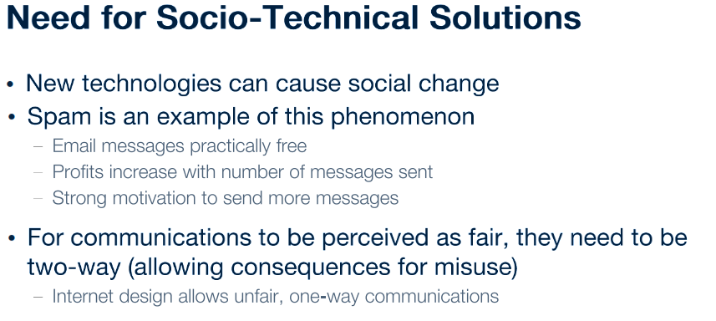
1-<number>

Slide 21
3.3 Internet Interactions
1-<number>

Slide 22
Pornography
1-<number>

Slide 23
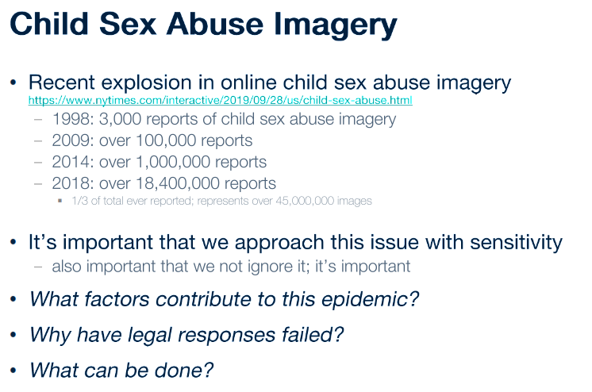
1-<number>

Slide 24
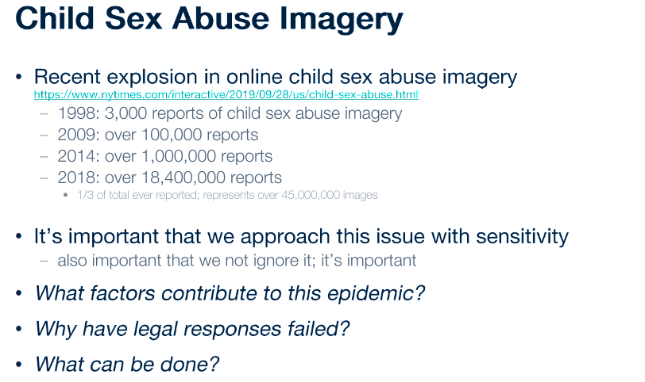
1-<number>

Slide 25
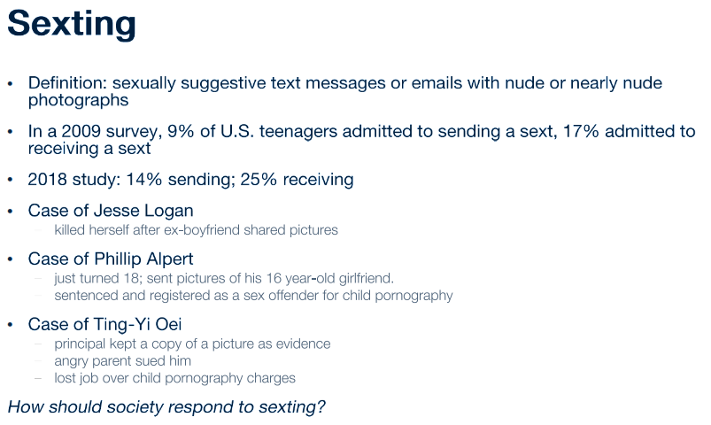
1-<number>

Slide 26
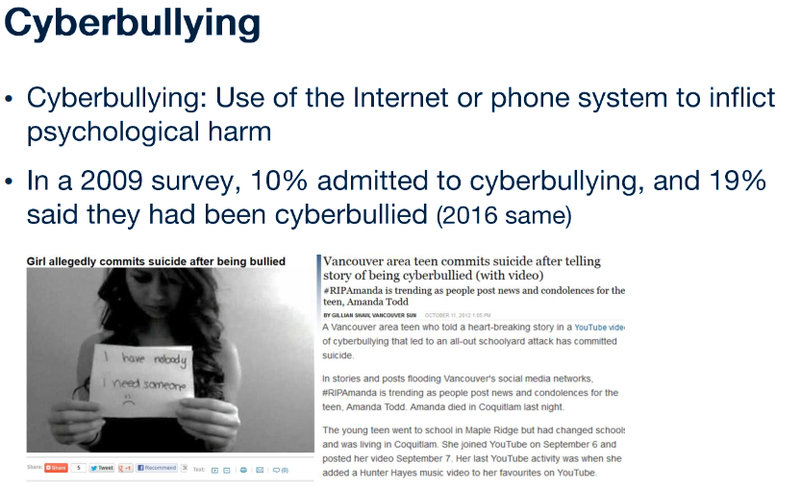
1-<number>

Slide 27
3.4 Text Messaging
1-<number>

Slide 28
Transforming Lives in Developing Countries
M-PESA in Kenya
  Save money
  Pay bills
  Transfer funds
Communicate information about crop prices
Protect against counterfeit medicine
1-<number>

Slide 29
Twitter
Web-based social networking service
More than 200 million users
Blogging tool
Business promotion
Role in Arab Spring uprisings debated
  (+) Social networks lead to politicization
  (-) Ties in social networks too weak for high-risk activism
1-<number>

Slide 30
3.5 Censorship
1-<number>

Slide 31
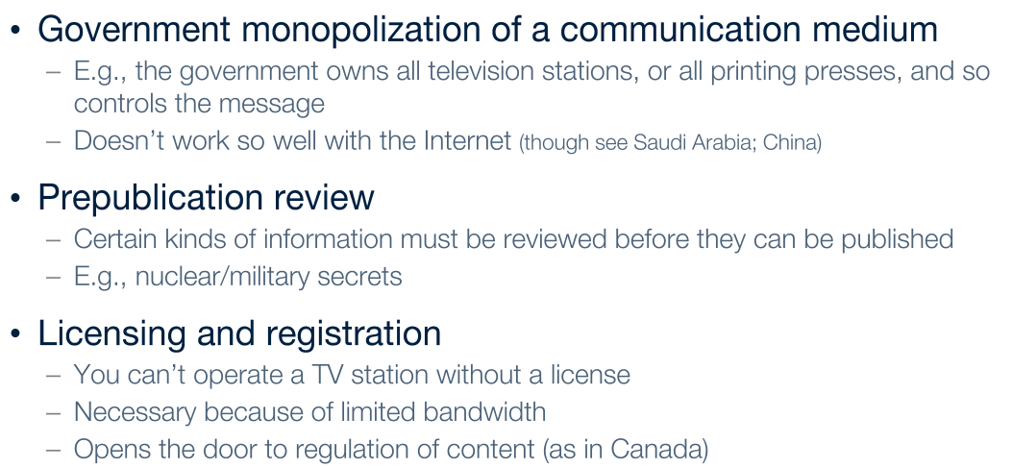
Forms of Direct Censorship
Government monopolization
Prepublication review
Licensing and registration
1-<number>

Slide 32
Self-censorship
Most common form of censorship
Group decides for itself not to publish
Reasons
  Avoid subsequent persecution
  Maintain good relations with government officials (sources of information)
Ratings systems created to advise potential audience
  Movies, TVs, CDs, video games
  Not the Web
1-<number>

Slide 33
Governmental Filtering and Surveillance
Cuba, North Korea: Internet virtually inaccessible
Saudi Arabia: centralized control center
People’s Republic of China:
  Blocks Internet access at times of social unrest
  Has “one of most sophisticated filtering systems in the world”
Germany: Forbids access to neo-Nazi sites
United States: Have been repeated efforts to limit access of minors to pornography
1-<number>

Slide 34
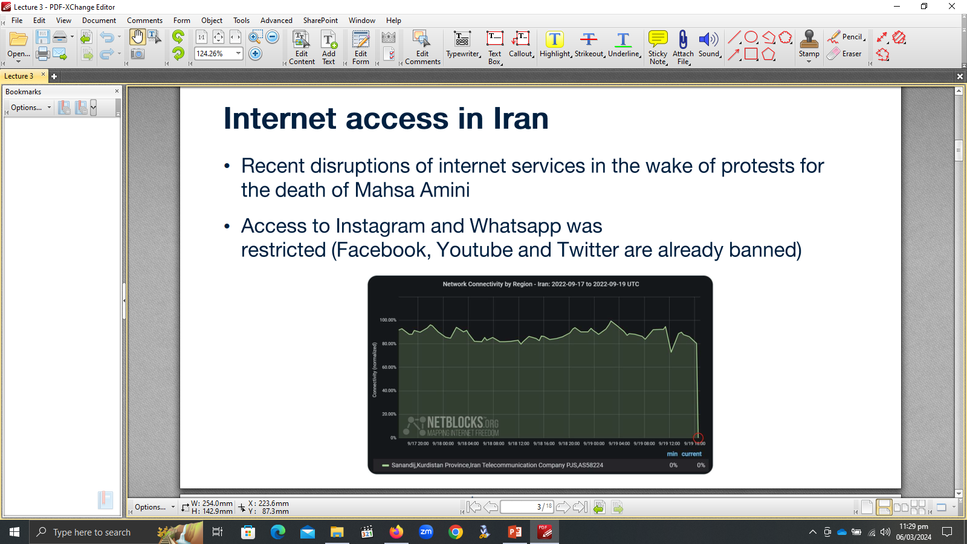
1-<number>

Slide 35
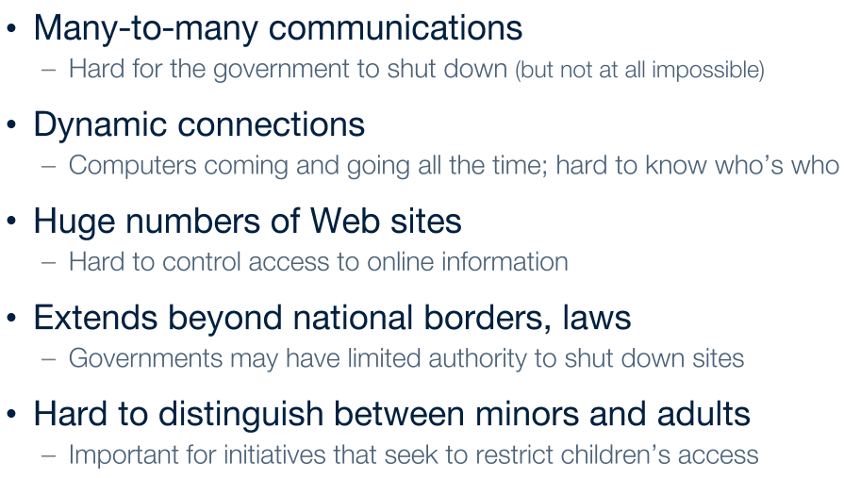
Challenges Posed by the Internet
Many-to-many communications
Dynamic connections
Huge numbers of Web sites
Extends beyond national borders, laws
Hard to distinguish between minors and adults
1-<number>

Slide 36
Ethical Perspectives on Censorship
Kant opposed censorship
  Enlightenment thinker
  “Have courage to use your own reason”
Mill opposed censorship
  No one is infallible
  Any opinion may contain a kernel of truth
  Truth revealed in class of ideas
  Ideas resulting from discourse are more influential
1-<number>

Slide 37
Mill’s Principle of Harm
“The only ground on which intervention
is justified is to prevent harm to others;
the individual’s own good is not a
sufficient condition.”
1-<number>

Slide 38
3.6 Freedom of Expression
1-<number>

Slide 39
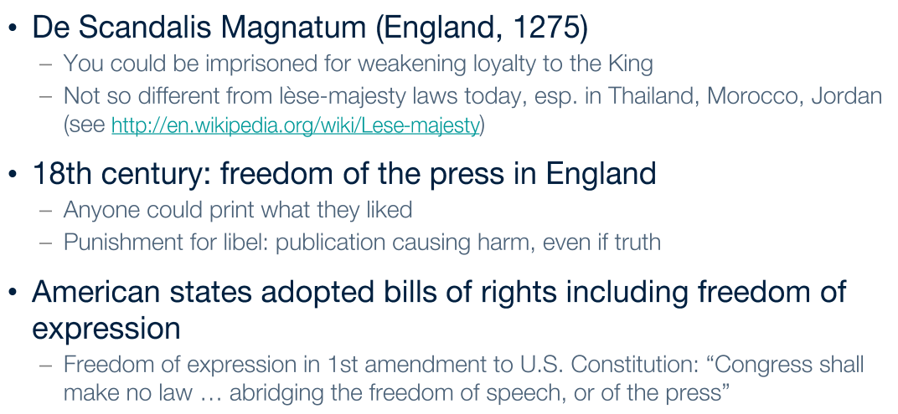
Freedom of Expression: History
1-<number>

Slide 40
1st Amendment to U.S. Constitution
Congress shall make no law respecting an
establishment of religion, or prohibiting the
free exercise thereof; or abridging the
freedom of speech, or of the press; or the
right of the people peaceably to assemble,
and to petition the government for a
redress of grievances.
1-<number>

Slide 41
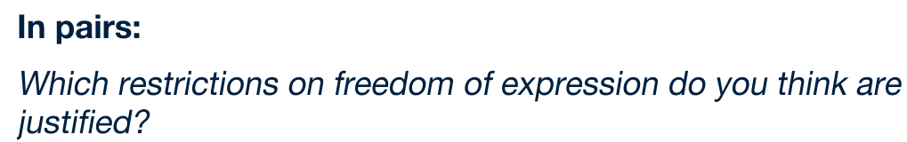
Freedom of Expression
Not an Absolute Right
1st Amendment covers political and nonpolitical speech
Right to freedom of expression must be balanced against the public good
Various restrictions on freedom of expression exist
1-<number>

Slide 42
Case Study: Kate’s Blog
Kate: Maintains a popular “life on campus” blog
Jerry: Another student; active in Whig Party
At private birthday party, someone gives Jerry a Tory Party T-shirt as a gag, and Jerry puts it on
Kate uses cell phone to take picture of Jerry when he isn’t looking, posts it on her blog
Story read by many people on and off campus
Jerry confronts Kate and demands she remove photo; she complies, and they remain friends
Kate’s blog and Jerry both become more popular
1-<number>

Slide 43
Kantian Analysis
Kate uploaded Jerry’s photo to her blog without asking his permission
She treated him as a means to her end of increasing the readership of her Web site
Her action was wrong
1-<number>

Slide 44
Social Contract Theory Analysis
Birthday party held in apartment of one of Jerry’s friends
Jerry had a reasonable expectation of privacy
Kate violated Jerry’s right to privacy
Kate’s action was wrong
1-<number>

Slide 45
Act Utilitarian Analysis
Benefits
  Popularity of Kate’s blog increased (definitely)
  Jerry become more popular on campus (definitely)
Harms
  Jerry’s anger at Kate (only temporary)
  Photo could discredit Jerry at some point in future (unlikely)
Benefits greater than harms, so Kate did a good thing
1-<number>

Slide 46
Social Contract Theory Analysis
Birthday party held in apartment of one of Jerry’s friends
Jerry had a reasonable expectation of privacy
Kate violated Jerry’s right to privacy
Kate’s action was wrong
1-<number>

Slide 47
Act Utilitarian Analysis
Benefits
  Popularity of Kate’s blog increased (definitely)
  Jerry become more popular on campus (definitely)
Harms
  Jerry’s anger at Kate (only temporary)
  Photo could discredit Jerry at some point in future (unlikely)
Benefits greater than harms, so Kate did a good thing
1-<number>

Slide 48
Rule Utilitarian Analysis
What if everyone were constantly taking photos of people they encountered and posting them?
Positive consequences
  People would have more opportunities to keep up with what their friends are doing
  People might be more reluctant to engage in illegal activities
Negative consequences
  People would become more self-conscious
  Some relationships would be harmed
Negative consequences more weighty than positive consequences, so Kate’s action was bad
1-<number>

Slide 49
Virtue Ethics Analysis
True friends trust each other and seek each other’s good
Reciprocity and equality are fundamental elements of friendship
Lack of reciprocity: Kate took something from Jerry without giving him anything in return
Lack of equality: She put her own interest above that of Jerry
Kate’s actions did not seem to be characteristic of a good friend
1-<number>

Slide 50
Summary
Four out of five analyses: Wrong for Kate to post the photo without asking Jerry’s permission
Kate figured it would be better to beg for forgiveness than ask for permission, but she cut Jerry out of a decision that affected both of them, and that’s no way to treat a friend
Kate should have tried to get Jerry’s consent
1-<number>

Slide 51
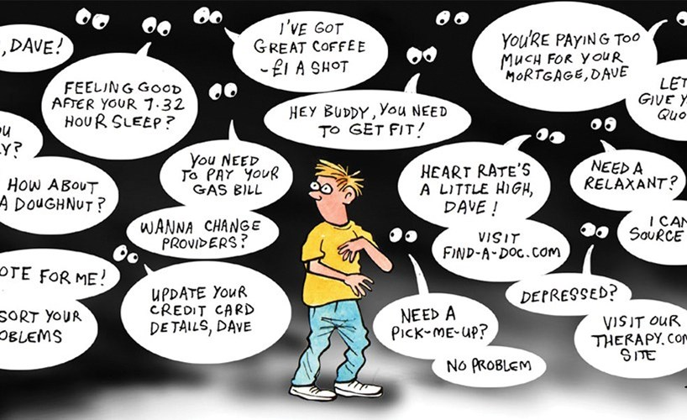

Slide 52
Tracking Apps
Location data forms the basis for a multibillion dollar industry. For eg, Mobilewalla, has data from 75,000 mobile apps and 1.6 billion devices across more than 35 countries.
Once you agree to tracking, the app will typically refer you to a privacy policy that details how that data can be used. Very few people read it.
Free apps are supported by sale of user information to third parties. Companies buy data for analytics, fraud detection, advertising and marketing purposes.

Slide 53
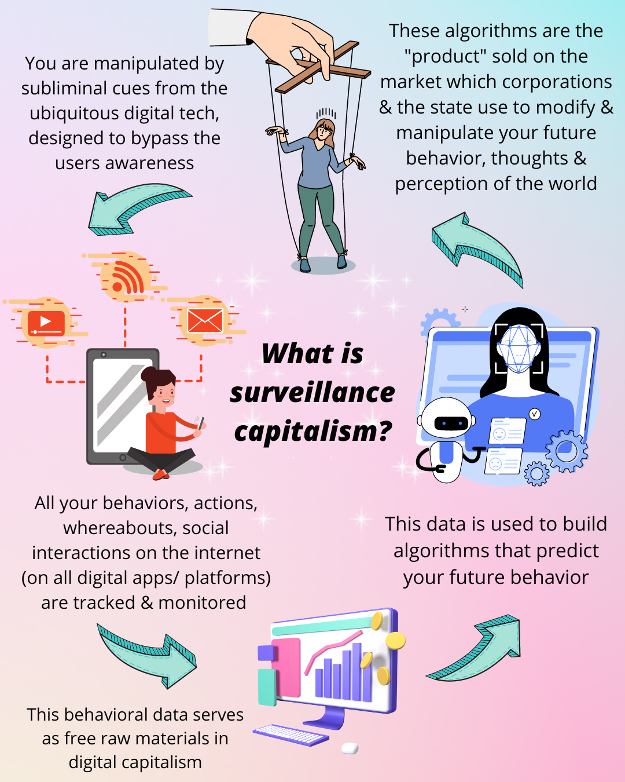

Slide 54
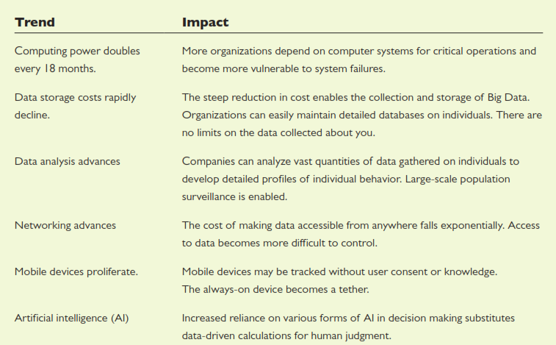
Technology Trends that Influence Ethical Issues

Slide 55
The World Wide Web
WWW : networked hypertext system
Stimulated tremendous growth in popularity of Internet
Two important attributes
  It is decentralized
  Every Web object has a unique address
1-<number>

Slide 56
Rise of the App
People spending more time on smartphones and tablets
Using Web browsers awkward on mobile devices
Mobile apps replace Web browsers as way to access Internet on mobile devices
1-<number>

Slide 57
How We Use the Internet
Shopping
Socializing (e.g., Facebook)
Contributing content (e.g., wikis)
Blogging
Crowdsourcing
Learning
Exploring our roots
Entering virtual worlds
Controlling the Internet of Things
Paying taxes
Gambling
Taking humanitarian action
Lots more!
1-<number>

Slide 58
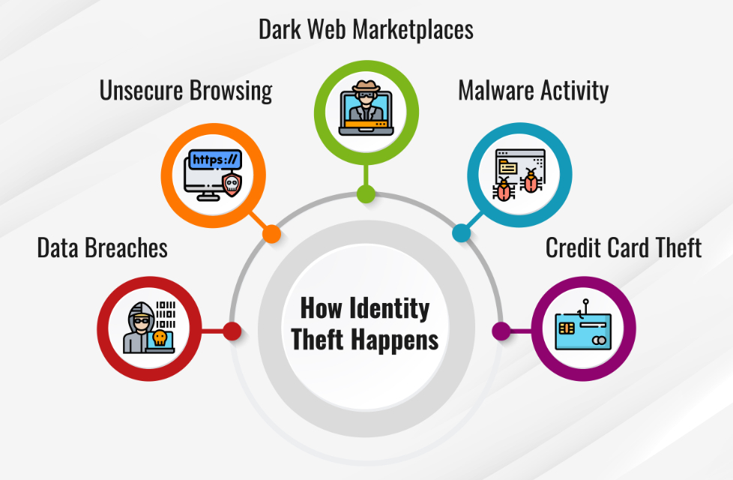
IDENTITY THEFT
The crime of using the personal or financial information of another person to commit fraud, such as making unauthorized transactions or purchases.
Committed in many different ways and its victims are typically left with damage to their credit, finances, and reputation
1-<number>

Slide 59
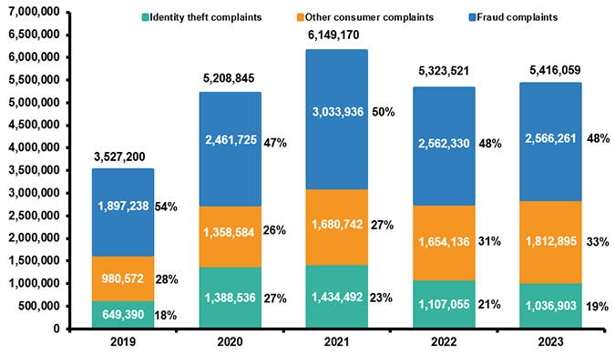
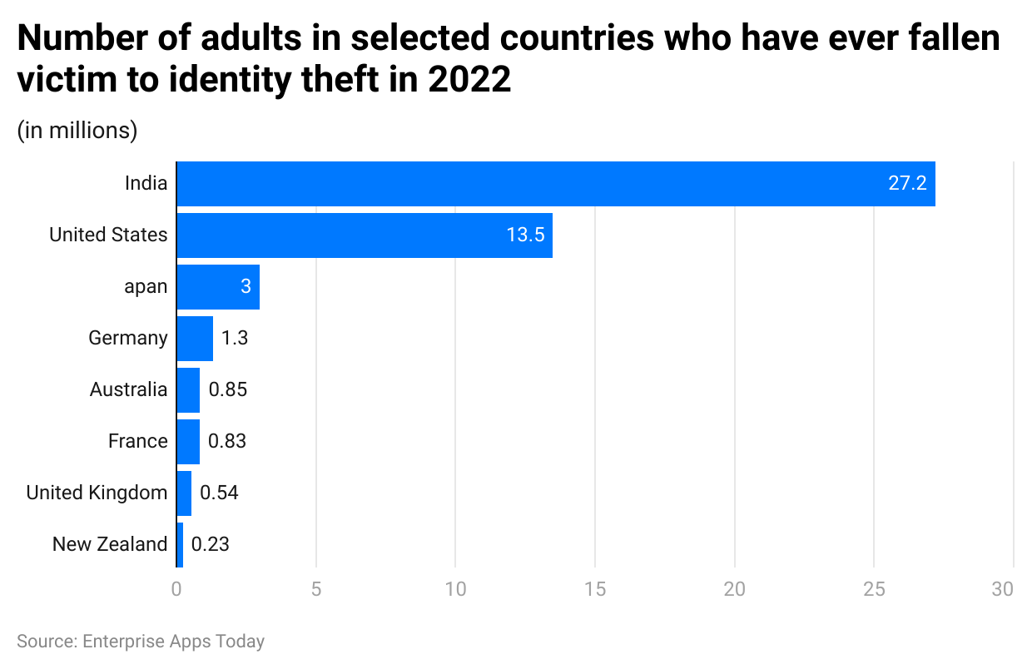
1-<number>

Slide 60
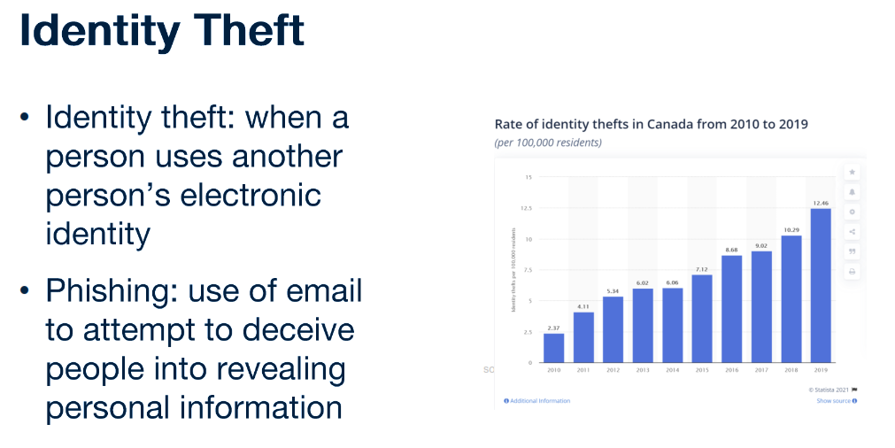
1-<number>

Slide 61
Identity Theft (1/2)
Identity theft: When a person uses another person’s electronic identity
Leading form of identity theft is credit card fraud
Financial institutions contribute to problem by making it easy to open new accounts
About 8 million cases of identity theft in U.S. in 2010
Consumer’s liability for credit card losses limited to $50
1-<number>

Slide 62
Identity Theft (2/2)
Nearly half of cases from lost credit card, checkbook, etc.
In 20% of cases, credit card number stolen at time of making purchase (skimmers)
About 1 million cases of identity theft annually in United States from online activities
Phishing: Use of email to attempt to deceive people into revealing personal information
Identity theft a federal crime, but only 1 in 700 cases results in an arrest
1-<number>

Slide 63
3.7 Children and Inappropriate Content
1-<number>

Slide 64
Web Filters
Web filter: Software that prevents display of certain Web pages
  May be installed on an individual PC
  ISP may provide service for customers
Methodologies
  Maintain “black list” of objectionable sites
  Examine content for objectionable words/phrases
1-<number>

Slide 65
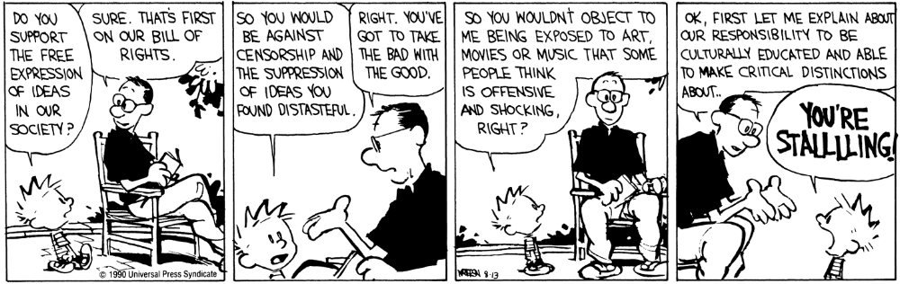
Calvin and Hobbes, 1990 / © Universal Press Syndicate
1-<number>

Slide 66
Child Internet Protection Act
Libraries receiving federal networking funds must filter pages containing obscenity or child pornography
U.S. Supreme Court ruled CIPA did not violate 1st Amendment guarantees
(6-3 decision in June 2003)
1-<number>

Slide 67
Ethical Evaluations of CIPA
Kantian evaluation: CIPA is wrong
Act utilitarian evaluation: depends on how benefits and harms are weighed
Social contract theory: freedom of conscience should be given precedence
1-<number>

Slide 68
3.8 Breaking Trust
1-<number>

Slide 69
Chat-Room Predators
Chat room: Supports real-time discussions among many people connected to network
Instant messaging and chat rooms replacing telephone for many people
Some pedophiles meeting children through chat rooms
Police countering with “sting” operations
1-<number>

Slide 70
Ethical Evaluations of “Stings”
Utilitarian evaluation
Kantian evaluation
Social contract theory evaluation
1-<number>

Slide 71
False Information
Quality of Web-based information varies widely
Other media also have information of varying quality
  The New York Times v. The National Enquirer
  60 Minutes v. Conspiracy Theory
Google attempts to reward quality
  Ranking uses “voting” algorithm
  If many links point to a page, Google search engine ranks that page higher
1-<number>

Slide 72
3.9 Internet Addiction
1-<number>

Slide 73
Is Internet Addiction Real?
Some liken compulsive computer use to pathological gambling
Traditional definition of addiction:
  Compulsive use of harmful substance or drug
  Knowledge of its long-term harm
Some people spend 40-80 hours/week on the Internet, with individual sessions lasting up to 20 hours
1-<number>

Slide 74
Is Internet Addiction Real?
Kimberly Young created test for Internet addiction
  Sample question: “Have you repeatedly made unsuccessful efforts to control, cut back, or stop Internet use?”
  Patients who answer “yes” to at least 5 of 8 questions may be addicted
Others disagree, noting
  Computer use is generally considered a positive activity
  Excessive use does not lead to criminal activity
  More accurate to call excessive use a compulsion
1-<number>

Slide 75
Contributing Factors
Social factors
  Peer groups
Situational factors
  Stress
  Lack of social support and intimacy
  Limited opportunities for productive activity
Individual factors
  Tendency to pursue activities to excess
  Lack of achievement
  Fear of failure
1-<number>

Slide 76
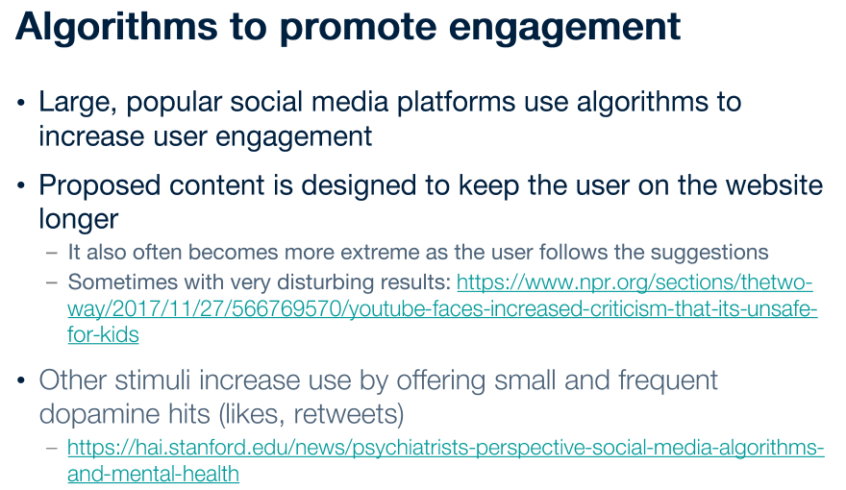
1-<number>

Slide 77
Ethical Evaluation
Enlightenment view
  Individuals can and should govern their lives
  People are responsible for their choices
Jeffrey Reiman’s view
  Addict’s behavior makes sense if addict has no hope for a better future
  Society bears responsibility for putting people in hopeless situations
1-<number>

